Slide 1


Problem Solving with the Internet of Things and Python
Unit 4 - BLE Connectivity
Notes:
Note from Doug. If you are using these materials, you can remove the CWRU logo and replace it with your own, but please retain the CC-BY logo on the first page as well as retain the acknowledgements page(s).

Slide 2
Lab 6
Intro to BLE

Slide 3
What is BLE?
You were introduced to BLE back in Unit 1.
“Bluetooth is a low-power, short-range radio technology that can connect and share data between electronic devices.”
from- https://www.popsci.com/reviews/how-does-bluetooth-work/

Slide 4
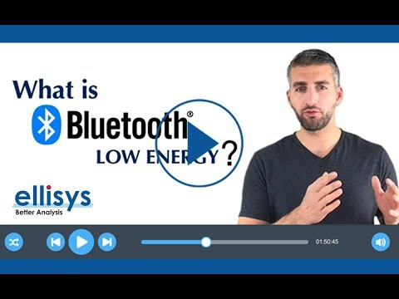
Intro to BLE

Slide 5
Who controls the BLE standards?
The Bluetooth Special Interest Group or Bluetooth SIG was formed in 1998.
This is a non-profit organization that does not make any Bluetooth devices but is comprised of members from many different companies that help define the Bluetooth standards and the future.
The groups most influential members are:
Ericsson (founding member)
Intel (founding member)
Nokia (founding member)
Toshiba (founding member)
Microsoft (member since 1999)
Lenovo (member since 2005)
Apple (member since 2015)

Slide 6
Let’s go to the source…
Bluetooth SIG
Once we get there, remember, we are interested in Bluetooth LE not Bluetooth Classic.

Slide 7
Just the facts
Frequency Band- 2.4GHz ISM Band (2.402 – 2.480 GHz Utilized)
Channels - 40 channels with 2 MHz spacing
(3 advertising channels/37 data channels)
Channel Usage - Frequency-Hopping Spread Spectrum (FHSS)
Data Rate - 125 Kb/s to a max of 2 Mb/s
Range - depends on power of transmitter but figure 10m or less for low power IoT devices
Connection Types - Point to Point, Mesh, Broadcast only

Slide 8
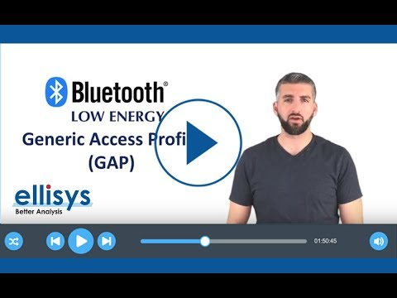
BLE connection modes

Slide 9
Setting up a BLE Connection
All BLE connections use a central / peripheral model. One end of the connection is the peripheral and the other end is the central.
Peripheral devices - advertise
“Hey, I am here. I can do these things and I am ready to connect…”
Central devices - Listen for available devices and connect to the ones they are interested in

Slide 10
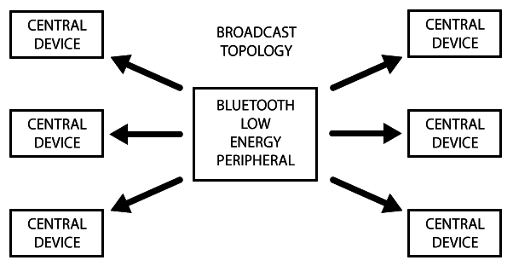
BLE connection - Broadcast only
Source: https://learn.adafruit.com/alltheiot-transports/bluetooth-btle
Notes:
Broadcast only is sometimes called BEACON MODE. Peripheral devices try to send small packets of data at regular intervals or on connection with an interested central device.

Slide 11
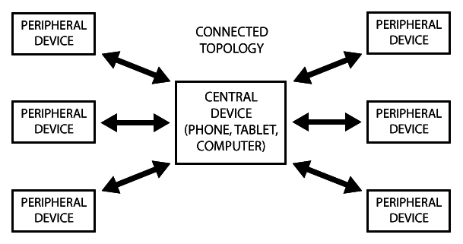
BLE connection - Point to point
Source: https://learn.adafruit.com/alltheiot-transports/bluetooth-btle
Notes:
The more powerful device - computer, tablet, cell phone, is typically the central device but smaller IoT devices can be set up centrals as well.

Slide 12
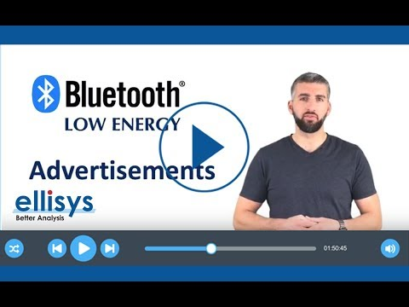
What is BLE Advertising?
NOTE: You should skip from about 3:10 until 5:10 of the video.

Slide 13
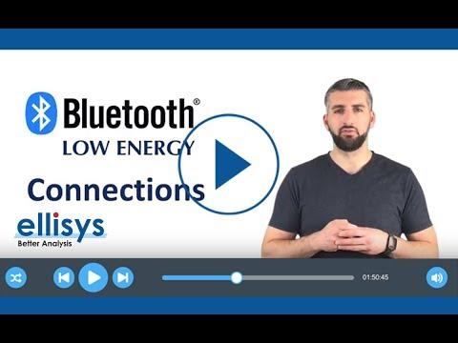
Deeper into BLE connections
NOTE: Watch until 3:15 mark, then skip remainder.

Slide 14
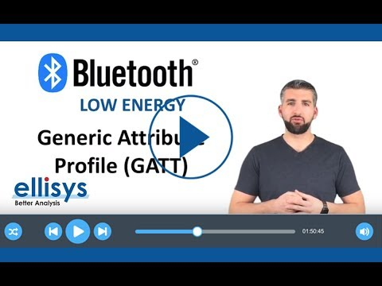
Even deeper into BLE connections

Slide 15
So many names!
central or peripheral?
master or slave ?
client or server ?

Slide 16
Central or Peripheral
PRIOR TO CONNECTION
The peripheral is the advertising device.
The central is the device listening to peripheral devices or that decides to connect to a peripheral device

Slide 17
Master or Slave
AFTER A CONNECTION IS ESTABLISHED
The peripheral becomes the slave device.
The central becomes the master device.

Slide 18
Client or Server
The client makes requests for data or sends commands.
This is typically the more powerful device, like a computer or cellphone.
The server sends data and responded to requests.
This is typically the IoT device!

Slide 19
Final look
Central → Master → Client
Typically the more powerful computing device.
Peripheral → Slave → Server
Typically the IoT device.

Slide 20
Lab 6
Lab 6 will introduce you to using BLE communication with the Adafruit Feather. Thankfully, we can import some useful libraries which will allow us to ignore many of the details (abstraction) about using BLE and just USE it to solve problems.

Slide 21
More resources
https://learn.adafruit.com/alltheiot-transports/bluetooth-btle
https://www.popsci.com/reviews/how-does-bluetooth-work/
Complete BLE video series

